Slide 1
AI Model Comparison for Symptom-Based Disease Diagnosis
Adaptable Nicotiana- Group1
Regular-TA :
Shadman Rohan
Project-TA :
Dalia Nasr

Slide 2
Members
Mahsa
Sheikholeslami
Aylin
Lehane
Roza
Hamidi
Nikhil
Mishra
Mohammad Hossein
Faramarzi

Slide 3
Table of Contents
01
02
03
04
Dataset
Preprocessing
Traditional models
KNN, X-GBoost
Neural Network
Results and discuss
BioBert and BioGPT
Result and discuss

Slide 4
01
Dataset and preprocessing

Slide 5
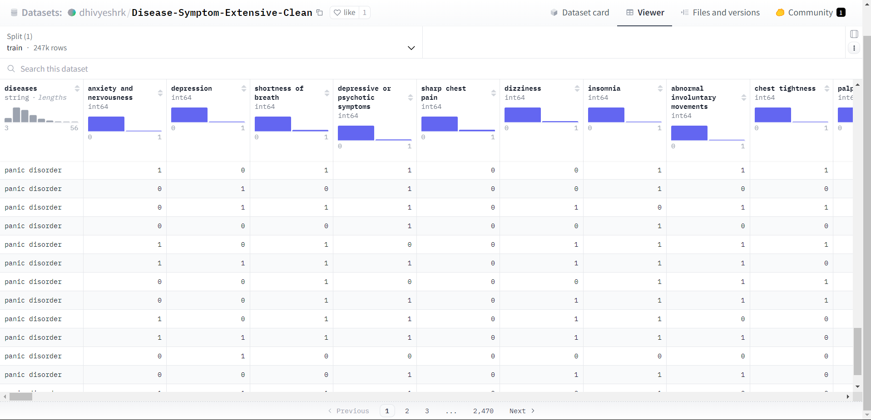
Get the data from hugging face
Balancing the data
Keep diseases with at least 50 entries
prepro-cceing
prepro-cceing
Delete duplicate rows

Slide 6
02
Traditional Models

Slide 7
XGBOOST
Accuracy: 79%

Slide 8
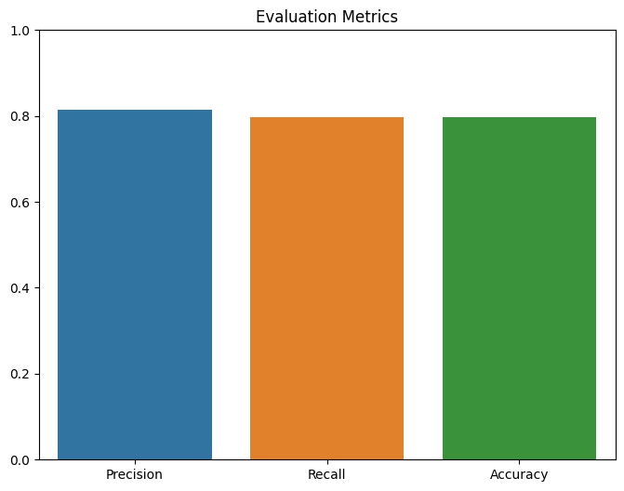

Slide 9
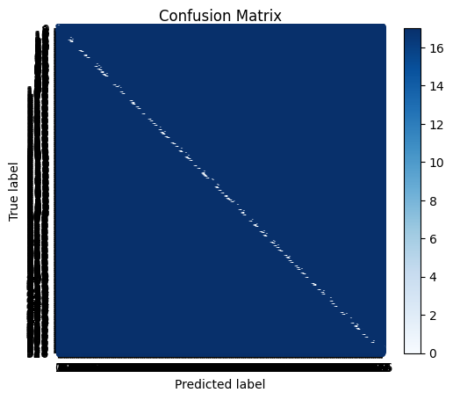

Slide 10
KNN MODEL
Accuracy: 81%

Slide 11
Process
k_values = range(1, 31)
grid_search = GridSearchCV(pipeline, param_grid, cv=10, scoring='accuracy')
grid_search.fit(X_train, y_train)
Best Parameters: {'knn__n_neighbors': 4, 'knn__weights': 'distance'}
Best Cross-Validated Score: 0.7983870967741936
best_model = grid_search.best_estimator_
y_pred = best_model.predict(X_test)
accuracy 0.81 5270
macro avg 0.82 0.81 0.80 5270
weighted avg 0.83 0.81 0.81 5270

Slide 12
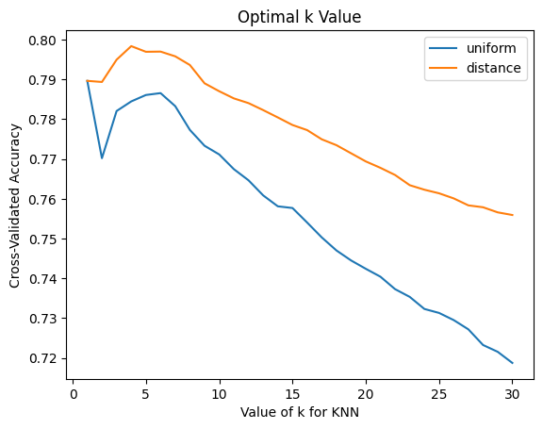

Slide 13
03
Neural network implementation

Slide 14
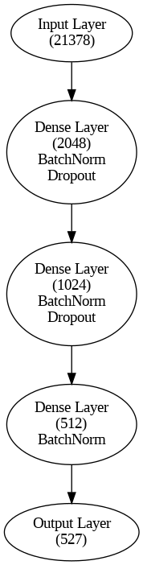
NeuralNet architecture
Test Accuracy:
81.48%
Precision:
84.44%
F1 Score:
81.7%

Slide 15
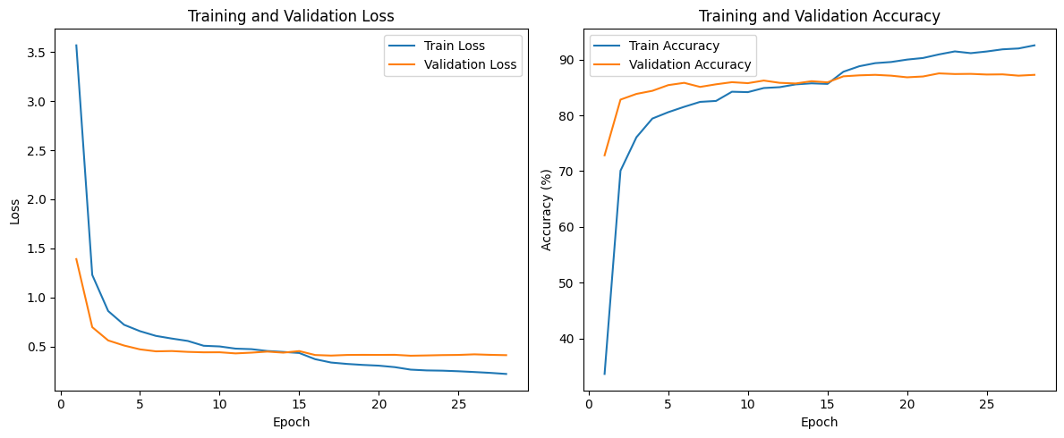

Slide 16
04
BioBert

Slide 17
BioBERT - A Brief Introduction
A pre-trained language model specifically for biomedical text mining.
Fine-tuned for various biomedical tasks such as named entity recognition, relation extraction, and question answering.
Develop a model to accurately classify diseases based on given symptoms using BioBERT.
Utilized the dmis-lab/biobert-base-cased-v1.1 version of BioBERT for effective symptom-disease classification.

Slide 18
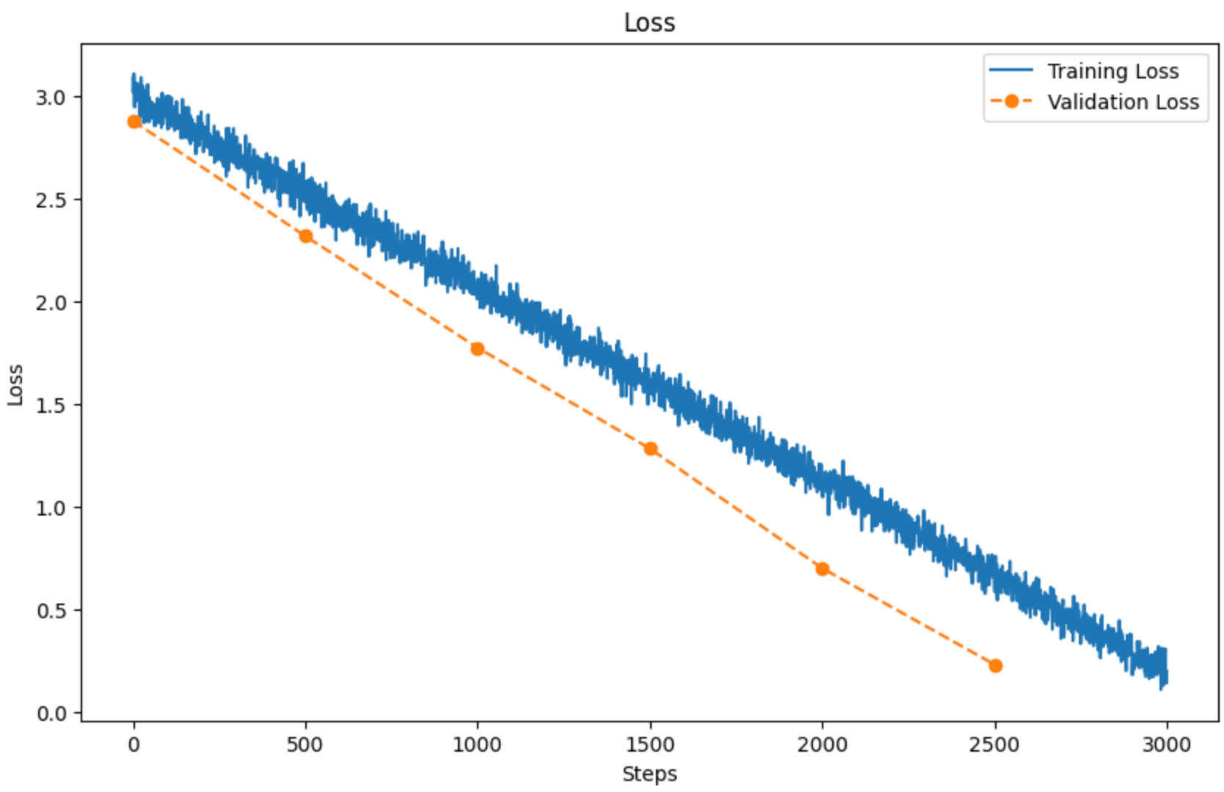
Results
Achieved 83% accuracy in the initial epochs.
Through optimization, increased accuracy to 87.1%.
Learning curve illustrating model performance over epochs:

Slide 19
05
BioGPT

Slide 20
Training pipeline
BioGPT model
Lora
trainer
Goal
Load the pretrained
multi -class
training
Lora config
Training args

Slide 21
Obstacles we faced!
Multi-class classification
Accuracy
Computational limits
Non-specific symptoms

Slide 22
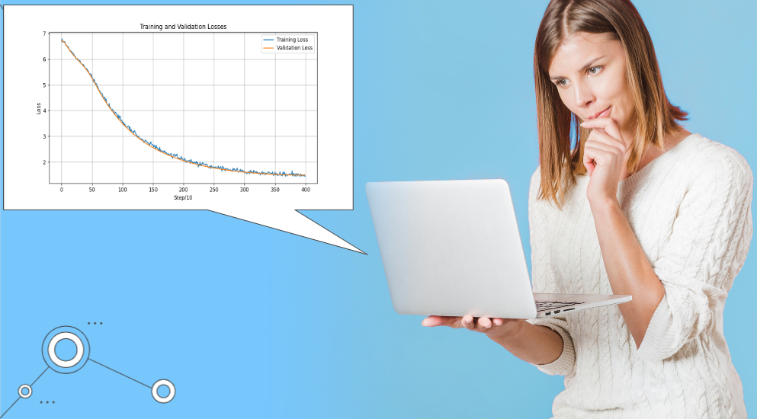

Slide 23
Thanks!

